Slide 1
Section 2.3
Transformations with
Reflections

Slide 2
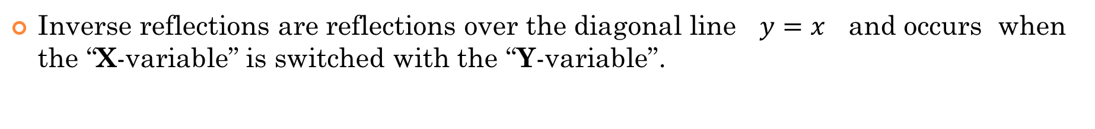
Reflections:
There are 3 types of reflections that we will discuss in this section:
Horizontal reflections are reflections over the Y-axis and occur when the x-variable is replaced with “negative x”.
Vertical reflections are reflections over the X-axis and occurs when the y-variable is replaced with “negative y”.
Inverse reflections are reflections over the diagonal line $y=x$ and occurs when the “X-variable” is switched with the “Y-variable”.

Slide 3
I) Reflections over the Axis
A reflection occurs when we flip an object over an axis (mirror line)
No rotations/translations/change in size
Vertical Reflection
Horizontal Reflection
Inverse Reflection
Reflected over
the X-axis
Reflected over
the Y-axis
Reflected over the
line y = x
y
y
y
5
5
5
4
4
4
3
3
3
2
2
2
1
1
x
1
x
x
-5
-4
-3
-2
-1
0
1
2
3
4
5
-5
-4
-3
-2
-1
0
1
2
3
4
5
-5
-4
-3
-2
-1
0
1
2
3
4
5
-1
-1
-1
-2
-2
-2
-3
-3
-3
-4
-4
-4
-5
-5
-5
© Copyright All Rights Reserved Homework Depot www.BCMath.ca

Slide 4
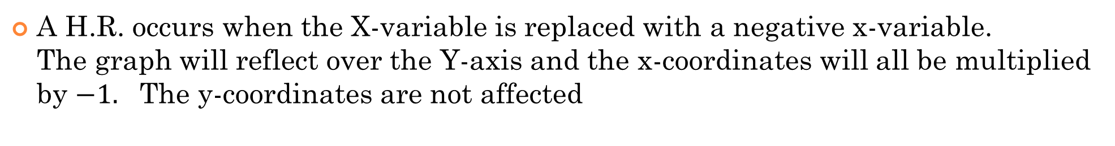
Horizontal Reflections:
A H.R. occurs when the X-variable is replaced with a negative x-variable.
The graph will reflect over the Y-axis and the x-coordinates will all be multiplied by $−1.$ The y-coordinates are not affected
Algebraically, a negative sign will be placed in front of each x-variable
y
y
8
8
6
6
4
4
2
2
x
x
-8
-6
-4
-2
0
2
4
6
8
-8
-6
-4
-2
0
2
4
6
8
-2
-2
-4
-4
-6
-6
-8
-8
© Copyright All Rights Reserved Homework Depot www.BCMath.ca

Slide 5
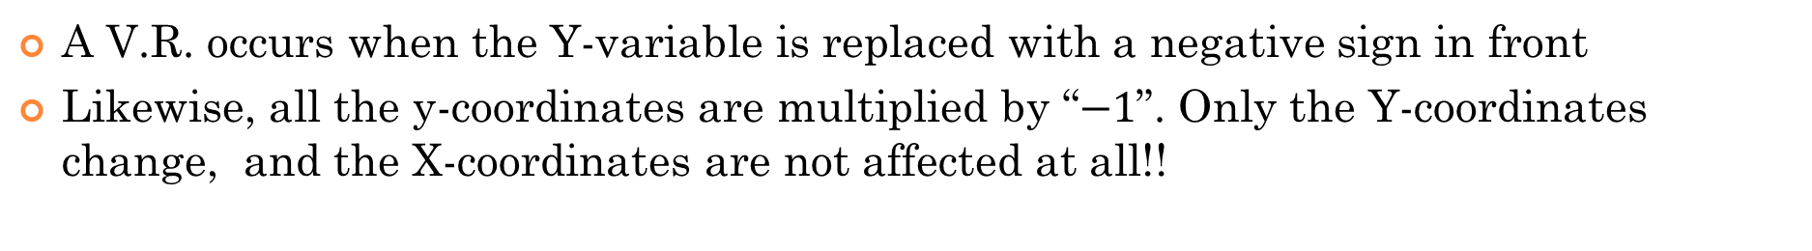
II) Vertical Reflections
A V.R. occurs when the Y-variable is replaced with a negative sign in front
Likewise, all the y-coordinates are multiplied by “$−1$”. Only the Y-coordinates change, and the X-coordinates are not affected at all!!
Y-Variable must be isolated!!
Algebraically, a negative sign will be placed in front of each x-variable
y
y
8
8
6
6
4
4
2
2
x
x
-8
-6
-4
-2
0
2
4
6
8
-8
-6
-4
-2
0
2
4
6
8
-2
-2
-4
-4
-6
-6
-8
-8
© Copyright All Rights Reserved Homework Depot www.BCMath.ca

Slide 6
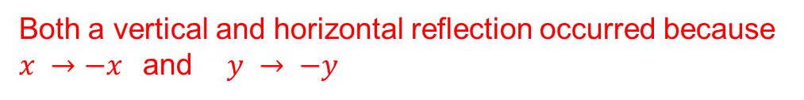

Difference Between H.R and V.R.
For H.R. the negative sign will be placed directly in front of the “x variable
For V.R. the negative sign will be placed directly in front of the “y variable”
This is a Horizontal Reflection because $X → −X$
This is a Vertical Reflection because $y→ −y$
Both a vertical and horizontal reflection occurred because
$x →−x$and $y → −y$
This transformation can be interpreted in two different ways
Vertical Reflection
Horizontal Reflection
© Copyright All Rights Reserved Homework Depot www.BCMath.ca

Slide 7
IV) Summary
Horizontal Reflection over the Y-axis
Vertical Reflection over the X-axis
The Y variable is always isolated, so
the Negative sign is often moved to
the other side
Inverse Reflection over the line
y = x
© Copyright All Rights Reserved Homework Depot www.BCMath.ca

Slide 8
Ex: Indicate the type of reflection for each transformation:
Vertical Reflection!
Vertical Reflection!
Horizontal Reflection!
Horizontal Reflection!
Inverse Reflection!
© Copyright All Rights Reserved Homework Depot www.BCMath.ca

Slide 9
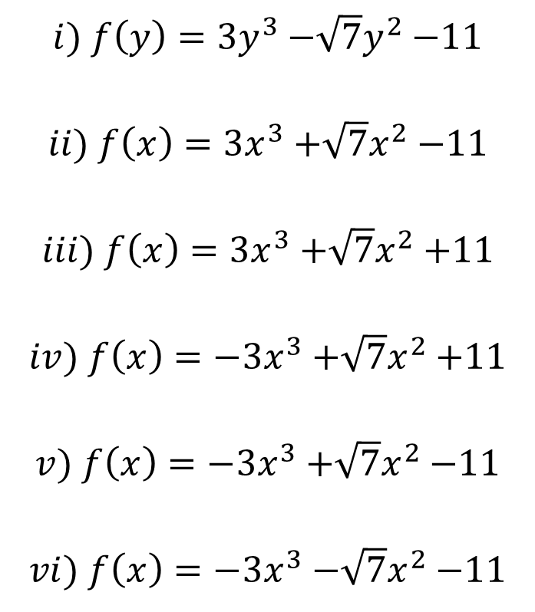
Ex: Given the equation $g\left(x\right)=3x^{3}{−\sqrt{7}x}^{2}−11$, what will the equation look like after each reflection?
i) Horizontal reflection
$$i) f\left(y\right)=3y^{3}{−\sqrt{7}y}^{2}−11$$
$$ii) f\left(x\right)=3x^{3}{+\sqrt{7}x}^{2}−11$$
$$iii) f\left(x\right)=3x^{3}{+\sqrt{7}x}^{2}+11$$
$$iv) f\left(x\right)=−3x^{3}{+\sqrt{7}x}^{2}+11$$
$$v) f\left(x\right)=−3x^{3}{+\sqrt{7}x}^{2}−11$$
$$vi) f\left(x\right)=−3x^{3}{−\sqrt{7}x}^{2}−11$$
ii) Vertical reflection
iii) Both Horizontal & Vertical reflection
iv) Inverse reflection

Slide 10
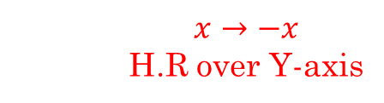
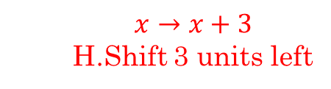
Combined Transformations Reflections with Translations
When you have both translations and reflections, you can order these transformations in different orders to get the same results.
Graph of $y=f(x)$ is shifted 3 units left
Graph of $y=f(x)$ is horizontally reflected over the Y-axis
????
The first method is the factoring method, where you read the transformations from left to right
H.Shift 3 units right
Horizontal Reflection over the Y-axis
2nd method is the “Circle” method, circle the variable in each step of the transformations and indicate how the variables are directed affected
$$x→x+3$$
H.Shift 3 units left
$$x→−x$$
H.R over Y-axis

Slide 11
Graphical Explanation of Multiple Transformation
Suppose you are given the function $y=\sqrt{x+2}$, indicate how the graph looks after the following transformation
Method 1: Factoring Method
Method 2: Circling Method
y
Step 1:
HR. over
Y-axis
y
Step 1:
HS 3 units left
4
4
2
2
Step 2:
HR over the
Y-axis
Step 2:
HS. 3 units
Right
x
x
-5
-4
-3
-2
-1
0
1
2
3
4
5
-5
-4
-3
-2
-1
0
1
2
3
4
5
BOTH transformations yield the same graph, that means they are the same and can be performed using either methods
-2
-2

Slide 12
When performing transformations with multiple steps, take the time to write out the transformation for each step
The factoring method and circling method may have transformation done in different orders but end up with the same overall result
Ex: Indicate the transformations in steps for each of the following. Perform your transformations in two different ways:

Slide 13
Practice: Indicate the transformations in order

Slide 14
Ex: Given that (a,b) is a point on y=f(x), find the coordinates of a point on the function:
V.R.
H.R.
Therefore, a new coordinate in the function will be:
V.R.
I.R.
I.R.
H.R.
Therefore, a new coordinate in the function will be:
© Copyright All Rights Reserved Homework Depot www.BCMath.ca

Slide 15
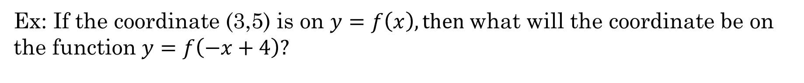
Ex: If the coordinate (3,5) is on $y=f\left(x\right), then$what will the coordinate be on the function $y=f\left(−x+4\right)?$
a) ($−3$,5) b) ($−7$,5) c) ($1$,5) d) ($3$,1) e) ($−3$,9)

Slide 16
Ex: Given the graph of y = f(x), draw the graph of
y
8
6
4
2
x
-8
-6
-4
-2
0
2
4
6
8
-2
-4
-6
-8
© Copyright All Rights Reserved Homework Depot www.BCMath.ca

Slide 17

y
8
6
4
$$\left(10x−\right)$$
$$\left(10x−\right)$$
2
x
-8
-6
-4
-2
0
2
4
6
8
-2
-4
-6
-8

Slide 18
What is an Inverse Reflection?
An Inverse Reflection is a reflection over the line $y=x$ (diagonal line)
An arrow pointing “UP” will reflect over the line pointing “RIGHT”
An arrow pointing “DOWN” will reflect over the line pointing “LEFT”
An inverse reflection will switch the coordinates $(a,b) → (b,a)$
When graphing the inverse of a function, take several points of the original function.
Switch the coordinates.
“X” cooridnates become “y” coordinates. “Y” coordinates become “x” coordinates.
Map these new points and then connect the dots to draw the inverse.
y
y
5
5
4
4
3
3
2
2
1
x
1
x
-5
-4
-3
-2
-1
0
1
2
3
4
5
-5
-4
-3
-2
-1
0
1
2
3
4
5
-1
-1
-2
-2
-3
-3
-4
-4
-5
-5

Slide 19
Practice: Perform an inverse reflection on the graphs below
y
y
8
8
6
6
4
4
2
2
x
x
-8
-6
-4
-2
0
2
4
6
8
-8
-6
-4
-2
0
2
4
6
8
-2
-2
-4
-4
-6
-6
-8
-8

Slide 20
Notations for Inverse Reflections
There are two different notations for an inverse reflection:
Inverse Transformation:
Inverse Function:
The “x” and “y” variables are switched in the function. No need to isolate the “y” variable. Perform all horizontal transformations on the “x” variable. Perform all vertical transformations are onto the “y” variable
Switch the “x” and “y” variables. However, we need to isolate the “Y’ variable to get the INVERSE FUNCTION!
The next slide will explain to you what an inverse function is……..
VS 2 UP
HC by a factor of ½
HS 4 LEFT
VR and 2 UP
VE by 3 and then 12 units UP
HT 4 LEft

Slide 21
Practice: indicate the transformations for each of the following
Start With Inverse Reflection
V.C by ½
V.S of 1 unit UP
Start With Inverse Reflection
First: Move the 4 to the left and then factor
H.C by 1/3
H.S of 4/3 LEFT
Start With Inverse Reflection
V.S of 17 DOWN
H.C by 1/5
V.S of 22 units UP
Start With Inverse Reflection
First: factor the “1/2’ inside the brackets
V.C. by 2/3
H.E. by 2
H.S. of 14 RIGHT
V.S. of 131 DOWN

Slide 22
Transformations with Inverse Reflections
The inverse reflection can be performed first or last in the transformation process, whichever is easiest for you!
KEY: write your transformations out in steps, stay ORGANIZED!!
Do Inverse Reflection LAST!!
Also factor and isolate left side
Start With Inverse Reflection
Read the transformations from left to right
HS 4 LEFT VS 2 DOWN
V.C. by 1/2
H.C. by 1/3
HC by ½ and VC by 1/3
HS 2/3 LEFT
VS 2 DOWN
LAST STEP, INVERSE REFLECTION

Slide 23
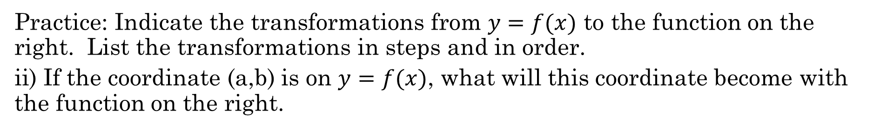
Practice: Indicate the transformations from $y=f(x)$ to the function on the right. List the transformations in steps and in order.
ii) If the coordinate (a,b) is on $y=f(x)$, what will this coordinate become with the function on the right.
First factor the coefficients of “x” and “y’
First factor the coefficients of “x” and “y’
Start With Inverse Reflection
Start With Inverse Reflection
HC by ½
VE by 3
HS of 3.5 LEFT
HC by 1/5
V.C by 1/2
H.S. of 2/5 LEFT
V.S of 2.5 UP
V.S of 4 DOWN

Slide 24
Ex: Given the graph of y = f(x), draw the graph of
y
8
6
4
2
x
-8
-6
-4
-2
0
2
4
6
8
-2
-4
-6
-8

Slide 25
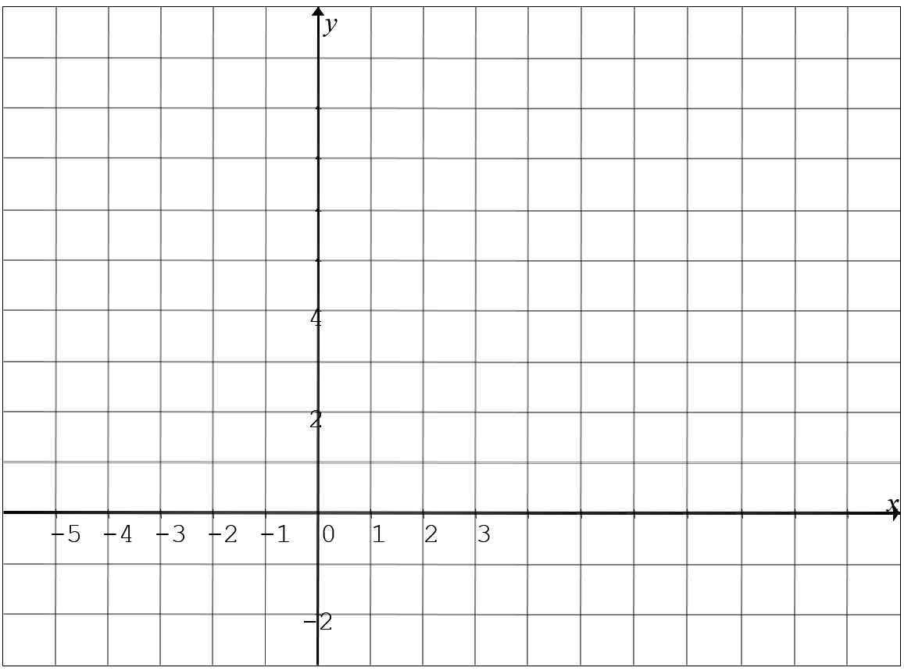
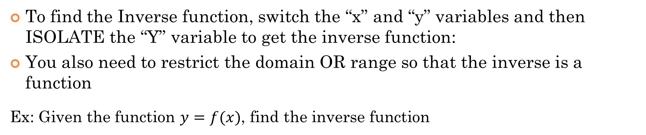

III) Finding the Inverse Function
To find the Inverse function, switch the “x” and “y” variables and then ISOLATE the “Y” variable to get the inverse function:
You also need to restrict the domain OR range so that the inverse is a function
Ex: Given the function $y=f(x)$, find the inverse function
$$y=x$$
The inverse is a parabola. We need to restrict our domain so it’s ONLY the RIGHT side of the parabola.

Slide 26
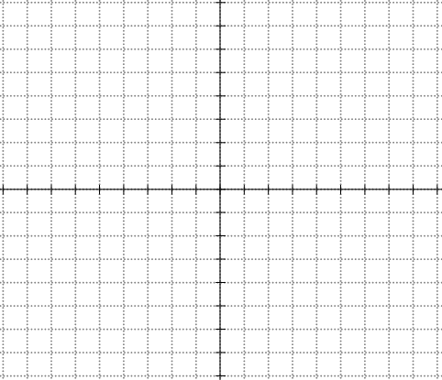
The Inverse of Quadratic Functions and ROOTS Functions
The inverse of a QF is not a function because it does not pass the vertical line test
So we must split the QF to two separate domains with the axis of symmetry. When the QF is broken into 2 parts, the inverse of each part will be a function
In contrast, the inverse of the top side of a radical function will be the RIGHT side of a parabola. So restrict the domain to the right side
We need to slip the parabola to LEFT and RIGHT sides and find each inverse separately
If we are finding the inverse of the Right side of a parabola, the inverse will be the top side
The inverse of the BOTTOM side of a radical function will be the LEFT side of a parabola. So restrict the domain to the LEFT side
If we are finding the inverse of the LEFT side of the parabola, the inverse will be the BOTTOM side
© Copyright all rights reserved to Homework depot: www.BCMath.ca

Slide 27
Find the inverse of the following function:
The inverse of the right side of the parabola will be the top:
Switch “x” and “y”
Square root both sides – plus or minus!
y
5
Since we are finding the inverse of the RIGHT side, the inverse will be the TOP side
4
3
2
1
x
-4
-3
-2
-1
0
1
2
3
4
5
6
7
-1
-2
-3
© Copyright all rights reserved to Homework depot: www.BCMath.ca
-4
-5

Slide 28
Practice: Find the inverse function :
Switch “x” and “y”
Isolate the “y” variable
Take the negative square root because the domain is on the left side
Since we are looking for the inverse of the “left” side of the parabola, the inverse function will be the “bottom” side of the root function
© Copyright all rights reserved to Homework depot: www.BCMath.ca

Slide 29
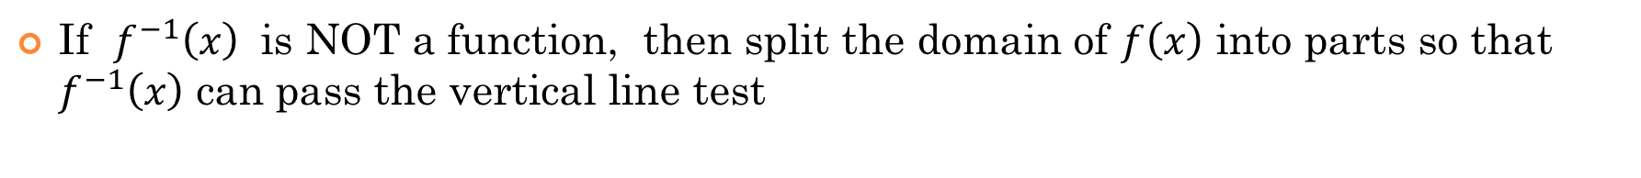
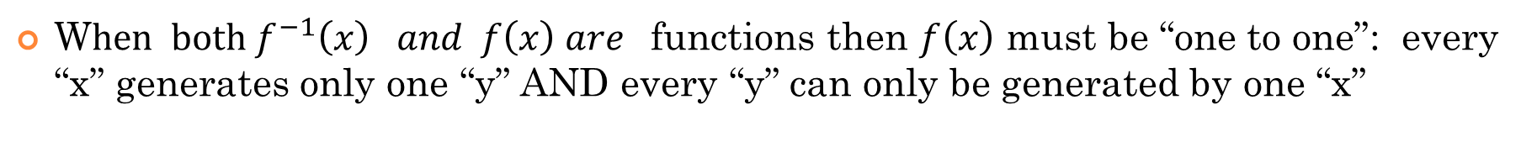
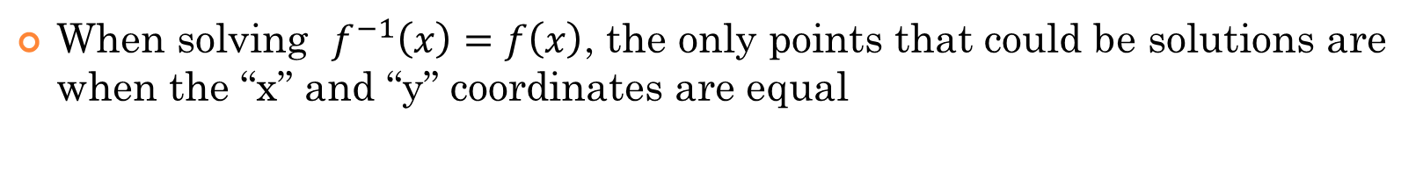
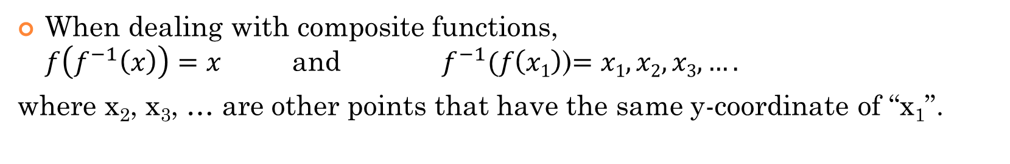
General Properties of Inverse Functions
If the point$\left(a,b\right) is on y=f\left(x\right), then f^{−1} (b)=a$
When dealing with composite functions,
$f\left(f^{−1}\left(x\right)\right)=x$ and $f^{−1}(f\left(x1\right)$)$=x1, x2, x3,….$
where x₂, x₃, … are other points that have the same y-coordinate of “x₁”.
When solving $f^{−1}\left(x\right)=f\left(x\right)$, the only points that could be solutions are when the “x” and “y” coordinates are equal
W$hen both f^{−1}\left(x\right) and f\left(x\right) are$functions then $f\left(x\right)$ must be “one to one”: every “x” generates only one “y” AND every “y” can only be generated by one “x”
If $f^{−1}\left(x\right)$ is NOT a function, then split the domain of $f\left(x\right)$ into parts so that $f^{−1}\left(x\right)$ can pass the vertical line test

Slide 30
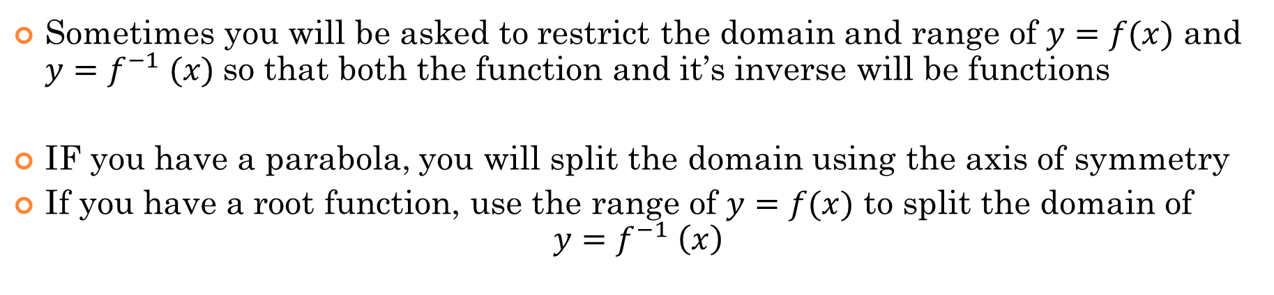
Domain and Range for Inverse Functions
Since we switch the x & y variables for the inverse reflection, the domain and range will also change
Sometimes you will be asked to restrict the domain and range of $y=f(x)$ and $y=f^{−1} (x)$so that both the function and it’s inverse will be functions
IF you have a parabola, you will split the domain using the axis of symmetry
If you have a root function, use the range of $y=f(x)$ to split the domain of
$y=f^{−1} \left(x\right)$
If both $y=f \left(x\right) and y=f^{−1} (x)$ are function, then we don’t need to bother with restricting the domain and range
© Copyright All Rights Reserved Homework Depot www.BCMath.ca

Slide 31
Practice: Given each function, find the inverse function when the graph is reflected over $y=x$. State the domain of the inverse function
Since the inverse of a parabola is not a function, then we will need to restrict the domain so that the inverse will be a function
Split the domain using the axis of symmetry at
x=3

Slide 32
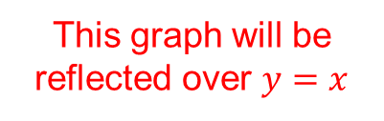
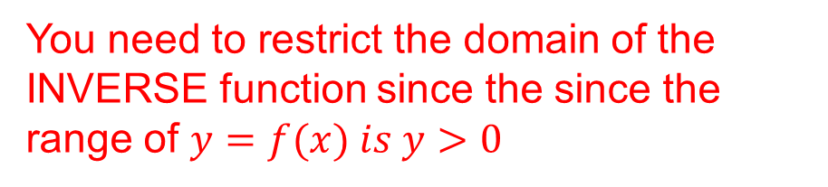

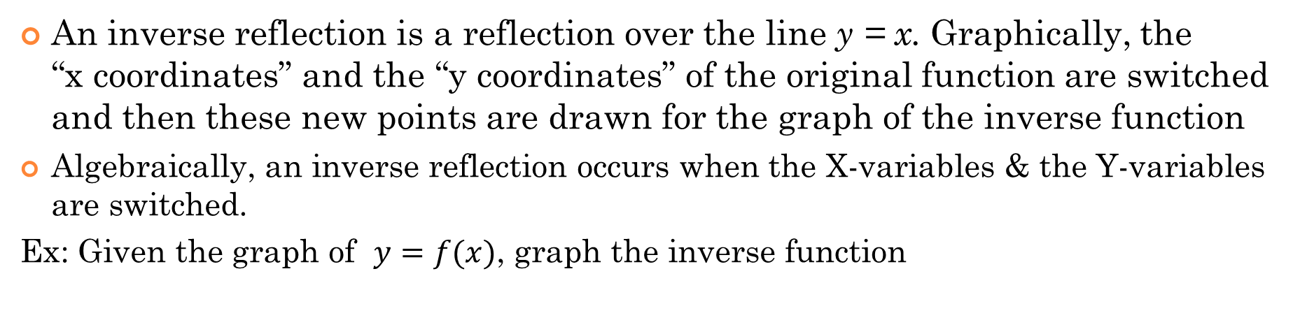
III) Inverse Reflection
An inverse reflection is a reflection over the line y = x. Graphically, the
“x coordinates” and the “y coordinates” of the original function are switched and then these new points are drawn for the graph of the inverse function
Algebraically, an inverse reflection occurs when the X-variables & the Y-variables are switched.
Ex: Given the graph of $y=f(x)$, graph the inverse function
Common etiquette would require you to isolate the “y” variable IFF the inverse is a function
y
IF the inverse is NOT a function, don’t bother isolating the Y-variable
This graph will be reflected over $y=x$
4
You need to restrict the domain of the INVERSE function since the since the range of $y=f(x) is y>0$
The x-coordinate and y-coordinates will be switched
2
x
-5
-4
-3
-2
-1
0
1
2
3
4
5
$$y=x$$
-2
© Copyright All Rights Reserved Homework Depot www.BCMath.ca

Slide 33
Domain and Range for Inverse Functions
Since we switch the x & y variables for the inverse reflection, the domain and range will also change
Sometimes you will be asked to restrict the domain and range of $y=f(x)$ and $y=f^{−1} (x)$so that both the function and it’s inverse will be functions
IF you have a parabola, you will split the domain using the axis of symmetry
If you have a root function, use the range of $y=f(x)$ to split the domain of
$y=f^{−1} \left(x\right)$
If both $y=f \left(x\right) and y=f^{−1} (x)$ are function, then we don’t need to bother with restricting the domain and range
© Copyright All Rights Reserved Homework Depot www.BCMath.ca

Slide 34
Practice: Given each function, find the inverse function when the graph is reflected over $y=x$. State the domain of the inverse function
Since the inverse of a parabola is not a function, then we will need to restrict the domain so that the inverse will be a function
Split the domain using the axis of symmetry at
x=3

